Slide 1


Fundamentals of RM
RM System and Process
Leadership in RM
Incident Investigation
RM Tools & Challenges
RM in Industry
People & Org.
Application and Perspectives
On Becoming a
Leader in Risk Management
ENGG404 - Lecture
Chapter 2.3:
Hazards and
Hazard Identification

Slide 2
Learning Outcomes:
Differentiate between a hazard, the severity of hazard, and consequences (impact on PEAP).
Describe and explain different types of hazards in terms of losses (including occupational and/or process safety), and the impact of the severity of those hazards.
Apply The Incident Model to identify hazards associated with an activity that could lead to a loss incident.
Explain “situational awareness” and its practical application.
Chapter 2.3: Hazard Identification
2
Notes:
2

Slide 3
ALE #1: What are Hazards?
Most hazards are seen as occupational safety issues.
Please confer!
What hazards did you manage in your work experiences?
Were these exclusively occupational, or did you manage some process safety hazards?
Chapter 2.3: Hazard Identification
3
Notes:
3

Slide 4
What are Hazards?
Most hazards are seen as exclusively occupational safety issues.
Do not overlook these as process safety issues.
Workers successfully manage their exposures on a daily basis.
Corrosive Substance | Toxicity | Inert Gas | Oxygen Deficiency
Radiation | Moving Equipment / Machinery | Noise | High Pressure
Vibration | Unstable Materials | High Temperature | Slippery Surfaces
Flammability | Cryogenic Temperature | Combustible Dust | Elevations
High Voltage | Vacuum | Pressure Cycling | Liquefied Gases
Consider corrosion: is it a hazard or a consequence?
Chapter 2.3: Hazard Identification
4
Notes:
4
It can be both – a hazard ie corrosive substance in a pipe or a consequence ie corrosion of rebar due to water penetration

Slide 5

How We Identify Hazards: The Knowledge-Based Approach
Based on knowledge of the inspector (the person looking for the hazards) and/or documented check-lists for use during an inspection.
Moving equipment and desire to gain access (think: conveyor)
Fuming sulfuric acid (corrosive material)
Weakened steel structures (corroded material)
Unbalanced rotating / reciprocating equipment
Ground fault
Slumping Walls
Chapter 2.3: Hazard Identification
5
Notes:
5
Different experts with specific expertise and experience in each of these areas would be used to id the hazards

Slide 6
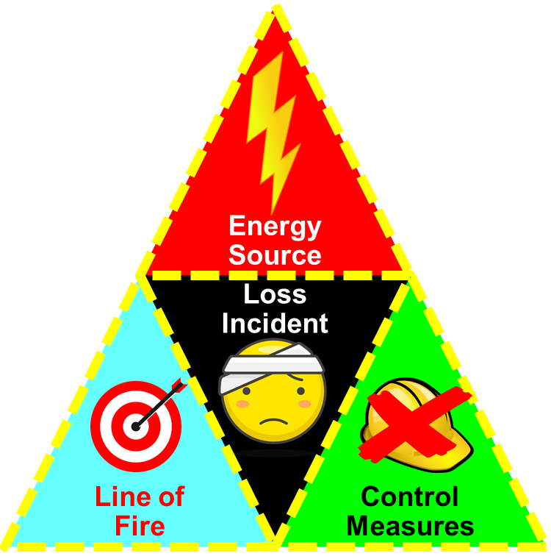
How to Identify Hazards: The Discovery Approach using the Incident Model
The Incident Model is a combination of:
Energy (controlled or uncontrolled release, or protected / unprotected exposure to a source), and
Line-of-Fire (no safe distance, separation, or space; intentional or not intentional), and
Control Measures (inadequate, defective, ineffective, or lack of)
… will result in a loss incident.
A triggering event (dashed lines) may:
Put someone or something in the line of fire, or
Initiate the release of an energy source, or
Defeat a control measure.
It follows that by mitigating one or more of these components of incident cause, incidents can be prevented.
Note: This technique can be applied for finding both
occupational safety hazards AND process safety hazards!
Chapter 2.3: Hazard Identification
6
Notes:
6

Slide 7
The Discovery Approach
Rephrase the components:
Find the Energy Source:
mechanical, electrical, chemical, etc.
Look for the Line-of-Fire:
bodies, assets, and environment that could
be harmed by a release of the energy source.
Look for No/Inadequate control measures:
the absence of the control measure or safeguard that is
preventing or limiting or controlling exposure to the energy source.
Find the Trigger: the circumstances or mechanisms that will:
Put someone or something in the line of fire, or
Initiate the release of an energy source, or
Defeat a control measure.
?
?
?
Chapter 2.3: Hazard Identification
7
Notes:
7
Hazards become evident.
A sharp observer can see hazards that may not be obvious.
Then can take steps to address the hazard and avoid an incident.
Effectively working to eliminate the immediate causes of incidents

Slide 8
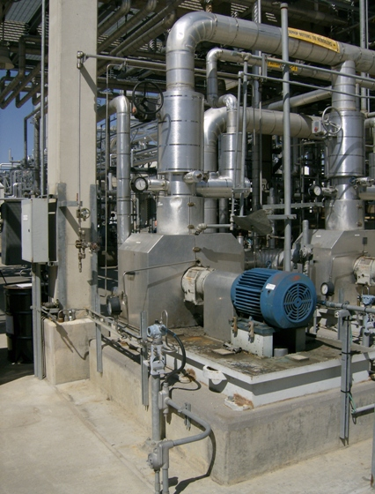
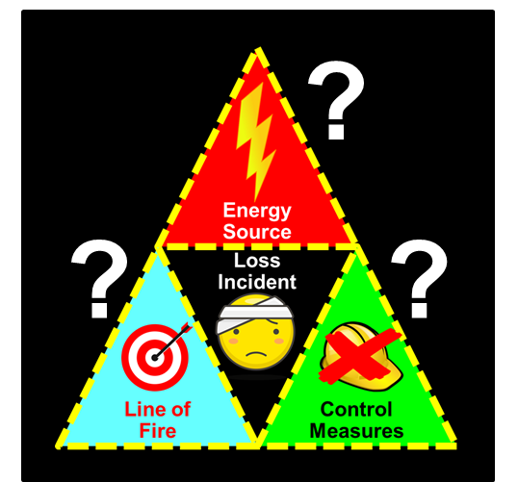
ALE #2: Applying the Discovery Approach
Equipment description:
The electrically-powered motor (blue) is connected to a pump (under the metal cladding). The piping contains light hydrocarbons (similar to gasoline) at high pressure and high temperature.
Activity:
The pump and motor are in operation.
Please confer ….
Identify some hazards in this photo:
FIND OR LOOK FOR:
Energy Sources: (These are fully controlled, but how might these become uncontrolled?)
Safeguards: (By identifying the safeguards, one can foresee the lack of safeguards.)
Trigger: (What could go wrong?)
Line-of-Fire: (Where might someone be in the line of fire if something failed?)
Chapter 2.3: Hazard Identification
8
Notes:
8

Slide 9
Applying the Discovery Approach
Energy Sources:
Rotating equipment: spinning shafts and coupling between motor and pump
Process fluid: hot, pressurized, flammable
Electrical: shock hazard, ignition source
Safeguards:
Coupling cover
Insulation, pressure-piping, pipe inspections, leak prevention leak detection
Insulation, wiring inspections, sealed
Trigger:
Loose or misplaced cover, failed coupling
Corrosion, loose pipe connections
Corrosion, water entry, damaged fittings
Line-of-Fire:
People working in area
Process unit operations
Chapter 2.3: Hazard Identification
9
Notes:
9

Slide 10


“Situational Awareness” and the Incident Model:
Situational Awareness:
A key skill in monitoring for hazards – by workers and leaders!
Relentless, almost continuous, assessment of a person’s surroundings for potential and actual hazards – just like you did in the previous ALE!
Achieved by asking those four questions about yourself, your equipment, your team, and your environment!:
FIND OR LOOK FOR:
Energy Sources: (These are fully controlled, but how might these become uncontrolled?)
Control Measures: (By identifying the safeguards, one can foresee the lack of safeguards.)
Line-of-Fire: (Where might someone or something be in the line of fire if something failed?)
Trigger: (What could go wrong?)
Your Environment
Your Team
Your Equipment
Yourself
Chapter 2.3: Hazard Identification
10
Notes:
10

Slide 11
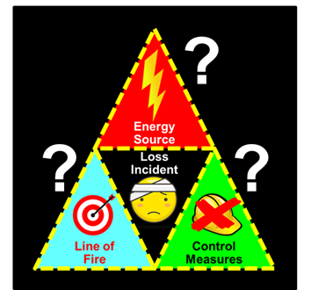
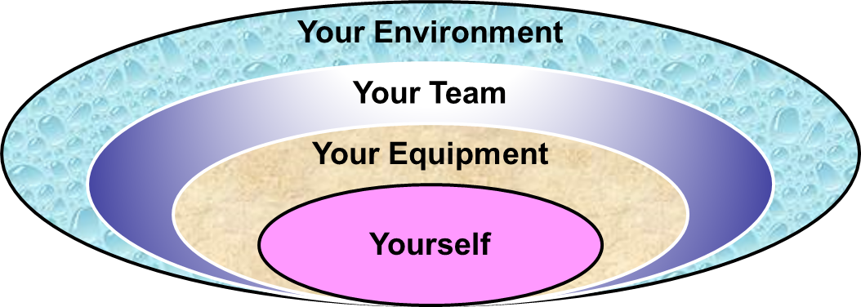
Summary and Key Lessons:
Hazards are associated with:
activities,
occupational losses
process safety losses
Hazards are often related to substandard
conditions and substandard work practices.
Context is important where there is a need to
differentiate between a hazard, severity of
hazard, and a consequence
We employ two approaches for identifying hazards:
Knowledge based
Discovery based.
Situational awareness is a
key skill!
Chapter 2.3: Hazard Identification
11
Notes:
11

Slide 12
Any questions?
Notes:
12

